Slide 1
Physical & Chemical Properties
What ‘s the matter with you

Slide 2
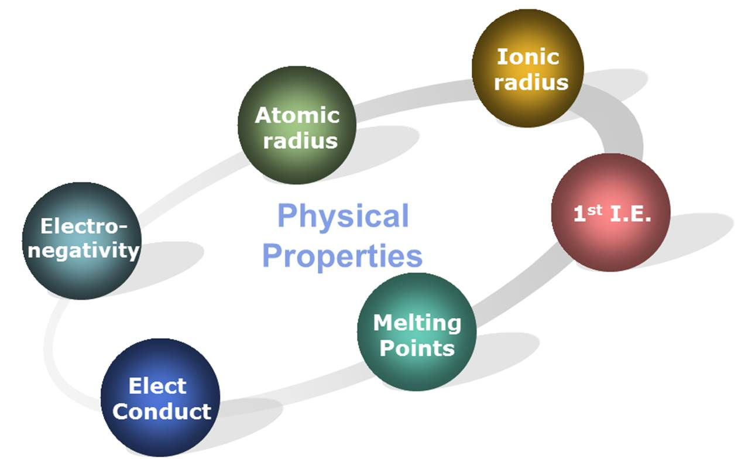
Properties of matter
Property: is a feature of a substance such as it’s appearance, smell or behaviour
Grouped into 2 categories: chemical and physical

Slide 3
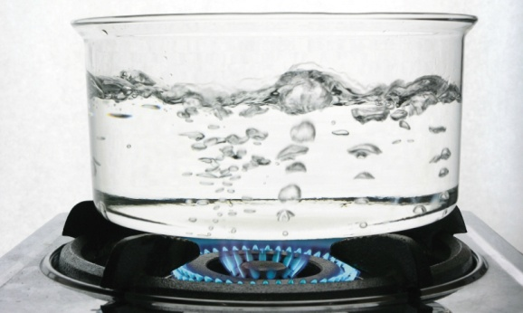
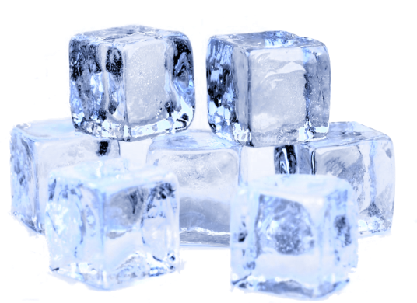
Physical property
Use your senses to describe it
Colour | Red, blue, green
State | solid, liquid gas
Ductility | made into wire
Malleability | bendable
Boiling point | When does it turn to gas
Melting point | When does it turn to liquid
Freezing point | When does it turn solid
conductivity | Does it conduct electricity
Solubility | Does it dissolve in water
Crystal form | Is it a crystal
Density
Viscosity | Is it watery is it thick like honey

Slide 4

Describe water
Uses your senses to describe it
Colour
clear
State (solid, liquid gas)
liquid
Ductility (made into wire)
no
Malleability (bendable)
no
Boiling point
100C
Melting point
0C
Freezing point
0C

Slide 5

Chemical property
When it changes into something new
Flash point
Reaction to water
Reaction to heating
Combustibility
Flammability
Toxicity

Slide 6
Properties of matter summary
Physical | Chemical
Colour State (solid liquid or gas) Ductility (made into wire) Malleability (bendable) Boiling point Melting point Freezing point Conductivity Solubility Crystal form | Flash point Reaction to water Reaction to heating Combustibility Flammability Toxicity * is a characteristic when one substance undergoes a chemical reaction

Slide 7
Practice
Classify the following is a physical or chemical property
Water boiling at 100 degrees C
Gasoline burning when exposed to flame
Sugar dissolving in water
Diamonds cutting glass
Dying your hair green
P
C
P
P
C

Slide 8
Physical Properties Gallery
Examine the samples of different types matter
Do NOT open the containers
Record three Physical Properties for each sample
Complete the worksheet
Share samples with other groups

Slide 9
Textbook Questions (ON Science 9 Academic)
Read Pages 149 to 159
Questions:
Page 156: #1, #3, #4
Page 159: #2, #4, #7, #8

